Slide 1
Microservices Reference Architecture
Mitch Ruebush, Yemi Kayode, Andy Bonham
Enterprise Architecture
3/27/2015
Notes:
Template version: 7/29/2013, for PowerPoint 2010

Slide 2
Executive Summary
Microservices is a new architecture style that provides various benefits over a traditional monolithic style architecture
Easier to understand and develop
smaller, simpler services
Faster to build and deploy
self contained independent services
less dependency management and regression testing
Easier to scale
Used as a solution by multiple cloud friendly companies to take advantage of cloud capabilities and become more resilient.
With those benefits come challenges that need to be addressed
Increased complexity due to being highly distributed and more components
Careful coordination is needed for features that span multiple services
As Capital One adopts the new microservices architectural style, teams will need guidance for when and when not to use them, how to build them, and the implications to consider
This Microservices Reference Architecture will provide high level guidance
Capability reference and component views, use cases, fit for purpose model, and patterns
Next Steps
A Microservices Architecture will provide the next level down of detail such as deployment views (e.g. hosting, containers), Security, Dev Ops, Governance, Resiliency, NFRs

Slide 3
Below is the scope of the Microservices Reference Architecture
Overview & Reference Models
Architecture Patterns
Fit for Purpose Model & Use Cases
Definition
Capability Reference Model
Component Model
Describe each component in detail
How to decompose a monolithic app
Event Driven Architecture
Event Broker (Choreography)
Event Mediator (orchestration)
Event Sourcing
Service Orchestrator
Command Query Responsibility Separation
Circuit Breaker
Use Cases
Efforts that divisions have identified as a fit for microservices, mapped back to use cases
Fit for purpose models
Microservice
Cloud ready
Future iterations of the architecture will focus on Application & Deployment Patterns, Security, Monitoring, Best Practices, Governance, Dev/Ops, Hosting, Cloud Resiliency

Slide 4
Below is the industry definition of a microservice along with the proposed Capital One definition
Overview
Sam Newman and Martin Fowler define microservices as:
a software architecture style, in which complex applications are composed of small, independent processes communicating with each other using language-agnostic APIs. These services are small, highly decoupled and focus on doing a small task
Below are the key characteristics of a microservice that we want to embrace. To be a microservice, you must meet each of these.
deployed as a unit
should have a well defined interface (may be things other than a RESTful API)
domain model description for which the microservice represents (i.e. bounded context)
has separate data and owns its own data (if applicable)
leverages Continuous Integration / Deployment (CI/CD)
is immutable and ephemeral
immutability provides clients flexibility for when to move to the new version by deploying a new version in production, instead of deploying over an existing version
ephemeral means the service can be short-lived; for example a microservice in a Docker container can be dynamic and spun up based on demand and then shutdown if not in use or if it is misbehaving;
Size is the one characteristic that is found in the industry definition that we are leaving out for now
Is subjective and can range depending on the use case

Slide 5
A microservice is …
Overview
A microservice … | A microservice is/does NOT…
Is independently deployable, you should not need to coordinate or ask permission to deploy a new microservice | Dependent on other microservices where everything must be tested and coordinated together to release a new microservice
Is exposed through a well defined and versioned interface | Exposed without an interface. Its domain model is reused/shared in other microservices.
Is defined through a domain model description, focused on doing one thing well and has a single responsibility | A microservice that has many responsibilities
Has separate data and may own its own data | Dependent on a shared data store (i.e. a data store that multiple, different microservices are dependent on) You can use a shared database, but should partition the data and use the security mechanisms to make sure a microservice can’t access the data directly.
The only way to get to the data owned by the microservice is through a well defined and versioned interface | Allow direct access to its data (e.g. direct connection to the DB)
Leverages continuous integration and delivery for automation | Leverage manual build/deployment mechanisms
Is immutable | Overwrite previous versions
Has ephemeral instances and the number of instances can be dynamically increased or decreased as needed | Have static instances so that the number of instances cannot be increased/decreased

Slide 6
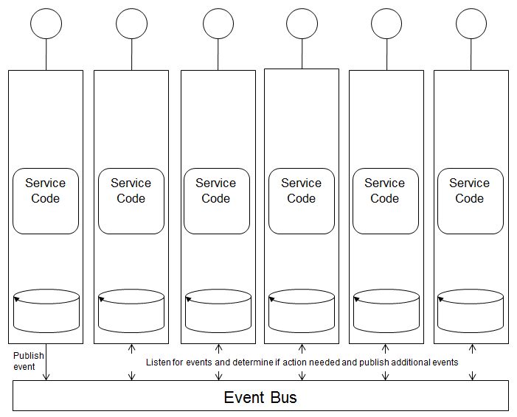
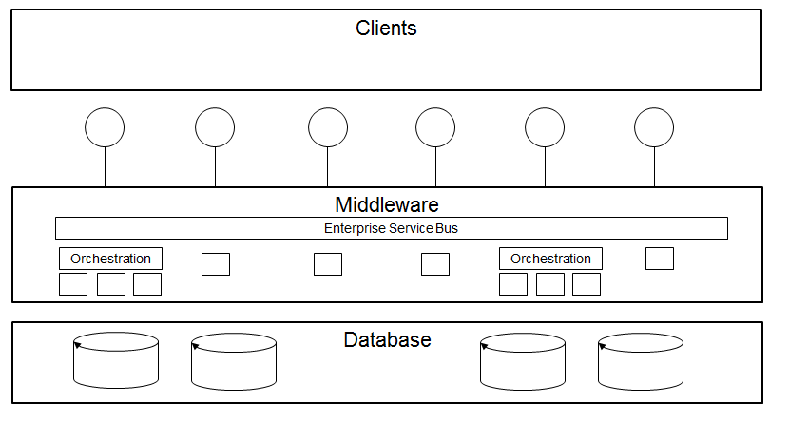
The key difference with Microservices over SOA is they provide increased agility and scalability
Overview
Category | SOA | Microservices
Deployment approach | Overwrite Deployments can “blow away” previous versions | Immutable A service is unchangeable once deployed This reduces risk, versions are the same and presents opportunity for true A/B testing on any feature
Component Stack | Dependent on other services A single data store is reused by many services | Independent Each service has its own layer (can include data store) Is deployed into its own container
Service Size | Larger | Smaller Finer grained, narrower scope
Assembly of multiple services | Orchestration Leverages a central Enterprise Service Bus (ESB) for command and control | Choreography/Coordination Services publish events over an event bus to keep other services synchronized
SOA illustration:
Microservices illustration:

Slide 7
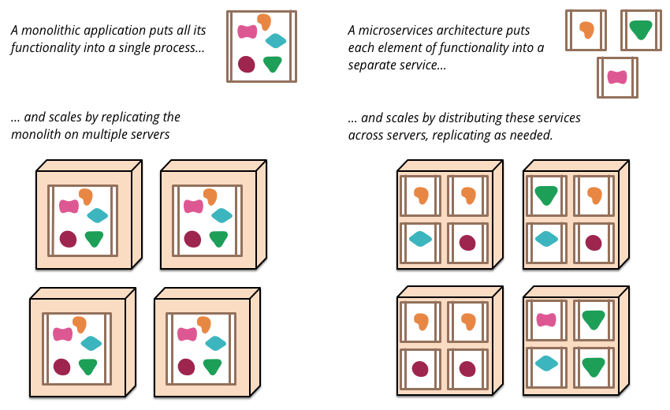
Below is a visual distinction between a traditional monolithic application and a microservices architecture
Overview
*This illustration is from http://martinfowler.com/articles/microservices.html

Slide 8
Below is a comparison between monolithic and microservice applications
Overview
Category | Monolithic App | Microservices App
Delivery | Slower Introducing a new feature often requires coordination with other features to deliver all of them at the same time | Faster Components are broken into smaller, simpler pieces and are independent. This makes them faster to build, deploy and scale along with being easier to understand and develop
Coupling | Higher Many dependencies on other components Low reusability as the functionality of a part cannot be reused alone | Lower Each service is independent and has its own stack, which means less dependencies (jar/classpath)
Reliability | Lower The failure of one component can potentially bring the entire monolith down (e.g. due to OutOfMemoryException) | Higher Better Fault isolation as each service is its own bounded context and is not coupled to another service Additional mechanisms (e.g. events) are needed to ensure data consistency across the system due to multiple database and transaction management
Effort to Support | High Large applications with many dependencies require high requirements on people’s mental capacity to keep the entire monolith in your head Apps grow in size and responsibilities over time Teams organize around applications | Lower (service) and Higher (distributed system) Requires different support model –teams organize around services Managing a distributed system requires addressing new complexities in development, testing, deploying, operating Automation with CI/CD is critical as there are more pieces moving faster through the lifecycle More run-time management and monitoring needs due to independent components (intermediaries such as service brokers and gateways) Features that span multiple services require careful coordination
Ability to use new technology | Harder To use new technologies you often need to rewrite the entire monolith (or use complicated solutions such as OSGi) | Easier Isolation and immutable approach enables a mix of technologies of technologies to be used

Slide 9
Microservices Landscape Capabilities and Deployments
Capability Reference Model
Distributed Application
Components
Frameworks
Client Libraries
Consumer Driven Contracts/Service Virtualization
Document Driven Contracts
Reactive Programming
Processing
Computation
Streaming
Rules Engines
Workflow
Eventing & Routing
Message Queuing
Event Registry & Discovery
Data Persistence
In-Memory Databases
Object Stores
RDBMS
NoSQL
Distributed File Systems
Distributed Computing Environment
Distributed Application Support Services
Monitoring
Log File Collection
Distributed Tracing
Stats Collection
Monitoring Console
Configuration
Resource Management
Scheduling
Service Discovery
Template System
Provisioning
Orchestration
Infrastructure Services
Public Cloud
Private Cloud
Multi Cloud
Packaging Services
Containers
Registry

Slide 10
Below is a view of Microservices Distributed Application Components
Capability Reference Model
Frameworks
Processing
Client Libraries
Consumer Driven Contracts / Service Virtualization
Computation
Streaming
Workflow
Finnagle
Pacto
Pact-net
VoltDB
Spring xD
jBPM
Pact-jvm
Parasoft
Reactor/LMAX
Salesforce
http://martinfowler.com/articles/consumerDrivenContracts.html
Storm
Pega
Rules Engines
Spark Streaming
Reactive Programming
Document Driven Contracts
Drools
Data Torrent
RxJS
Swagger
Blaze
RxJava
Blueprint
Bacon.js
RAML
http://apievangelist.com/2014/01/16/api-design-do-you-swagger-blueprint-or-raml/
Eventing & Routing
Data Persistence
In-memory DB
Column-Oriented
Object Stores
Distributed File Systems
Message Queuing
Event Registry and Discovery
VoltDB
RabbitMQ
AWS: SQS
Hazelcast
Cassandra
S3
HDFS
ActiveMQ
IBM MQ
Gemfire
HBase
Ceph
Gluster
Key Value
Document
Relational
zfs
Redis
MongoDB
PostgreSQL
Flocker
ElastiCache
AWS: RDS
Open Source
Commercial
Cloud
*the products above are some of the different options available in the industry today
Notes:
Real-time less than
Missing Analytics
Upstream analytics
Stream of Data

Slide 11
Below is a view of the Microservices Distributed Computing Environment
Capability Reference Model
Distributed Application Support Services
Monitoring
Provisioning
Template System
Resource Management
Log File Collection
Distributed Tracing
Terraform
Consul-Template
Go/Go-Template
Zipkin
Dynatrace
Chef
RightScale
Logstash
Shell/sed
Python/Jinja2
Kubernetes
ElasticSearch
Monitoring Console
Puppet
Ruby/ERB
Nagios
Hysterix
CloudFormation
Mesos
Solr
Kibana
Fleet
Splunk
Zatbix
Ansible
Scheduling Batch
Orchestration
Zenoss
Packer
Docker Compose (Fig)
Docker Swarm
Stats Collection
Chronos
Service Discovery
Spark
Kubernetes
Configuration
collectd
Consul
Docker 1.5
Consul
Scheduling Service
Etcd
Etcd
Marathon
Zookeeper
DNS
Aurora
Cassandra
ZooKeeper
Kubernetes
Infrastructure Services
Packaging Services
Private Cloud
Public Cloud
Containers
Open Stack
VMware
Azure
Docker
Rocket
AWS: Container Services
Google Compute Engine
AWS
Open Source
Commercial
Cloud
*the products above are some of the different options available in the industry today
Notes:
Real-time less than
Missing Analytics
Upstream analytics
Stream of Data

Slide 12
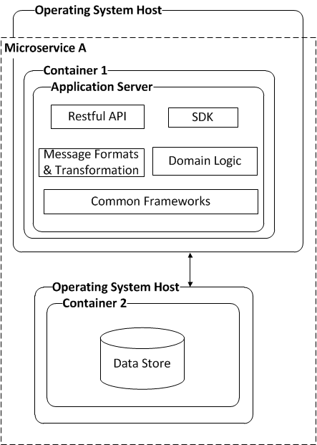
Microservice Component Diagram
Component
Model
*Container is a deployment best practice and can have a range of implementation options (e.g. JVM, Docker, etc)
*this data store can only be accessed by going through the microservice
System Overview
Container - includes the application and its dependencies and runs on an isolated process in the userspace on the host operating system.
This could be container specific software like Docker or could be a JVM.
Application Server – provides the run-time application server for the application components
Restful API – API that is exposed for external clients to call
SDK – leveraged by client applications and services to invoke Microservice capabilities that can be embedded in the client application
Message Formats & Transformation– Can contain message formats that are sent to and from the clients; Can also contain message formats in storage which may be different than those transmitted to the client and may require transformation
Domain Logic – Logic, business decisions, calculations, validations for the microservice
Common Frameworks – Common components for communication, caching, logging, security, messaging, storage (e.g. UPF or eAPI)
Data Store - Leveraged for data persistence for the microservice. Only is accessible by the microservice

Slide 13
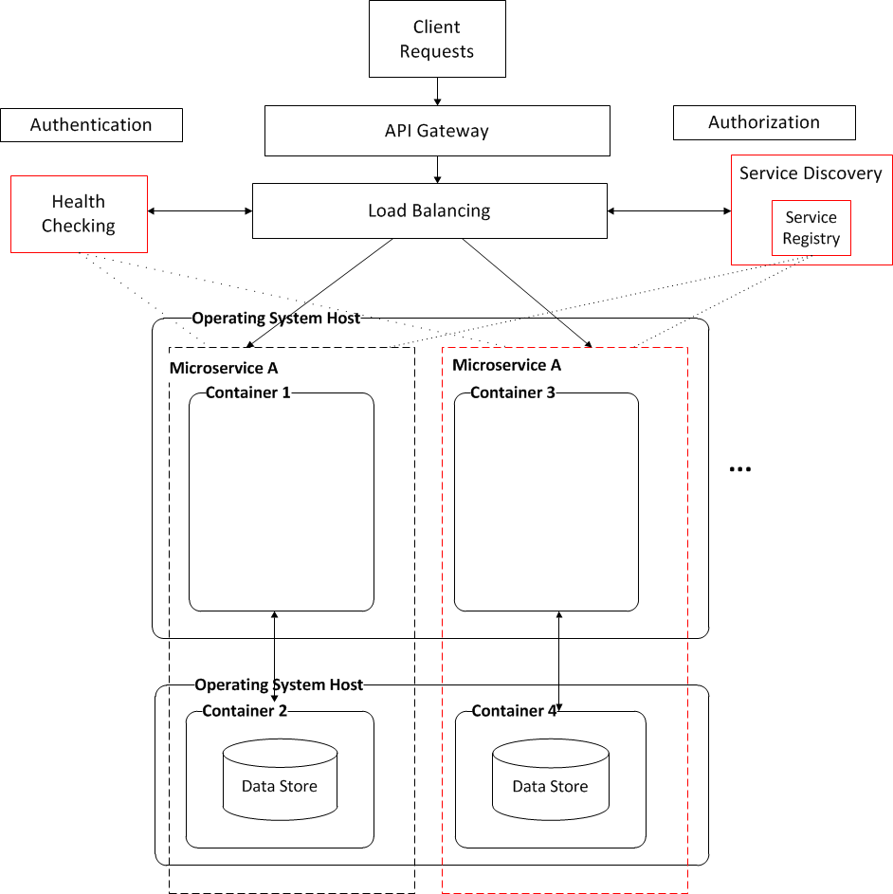
Microservice + Server-Side Service Discovery Component Diagram
Component
Model
*API Gateway would be leveraged for public APIs
*starts up/shuts down instances based on behavior or workload
*service instances register/unregister with the registry
*service instances register/unregister with the registry
System Overview
Authentication – capability that validates who the client is
Authorization – capability that confirms the authenticated client is authorized to call the service
Load Balancing – Spreads out the workload for a particular microservice across the various instances, using the service registry
Service Discovery/Registry – Keeps track of container instances that are added/deleted in a registry and provides to the load balancer
Health Checking – Monitors the service instances and creates/destroys new microservice container instances if needed
Container - includes the application and its dependencies and runs on an isolated process in the userspace on the host operating system.
Data Store - Leveraged for data persistence for the microservice. Only is accessible by the microservice

Slide 14
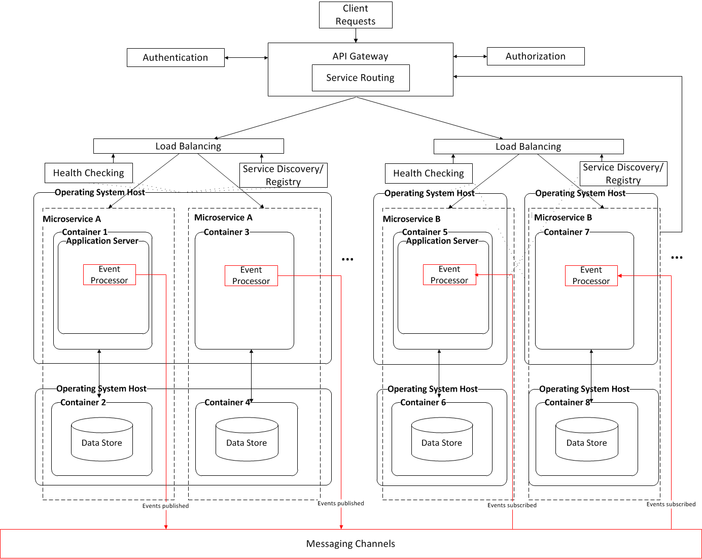
Microservice + Server-Side Service Discovery + EDA Broker Topology Component Diagram
Component
Model
*an application can be made up of multiple microservices
*Microservice B is calling public Microservice A through the API Gateway
*multiple containers of the same microservice can run in the same OS host (as depicted in Microservice A) or in separate OS hosts (as depicted in Microservice B)
*Microservice A publishes an event that Microservice B is subscribed to
System Overview
API Gateway - manages access to services and can enforce traffic management and security policy
Authentication – capability that validates who the client is
Authorization – capability that confirms the authenticated client is authorized to call the service
Service Routing – Routes requests to the right microservice based on configuration and policy
Load Balancing – Spreads out the workload for a particular microservice across the various instances, using the service registry
Event Bus – Publishes events to subscribers, subscribers take action if necessary on that event
Service Discovery/Registry – Keeps track of container instances that are added/deleted in a registry and provides to the load balancer
Health Checking – Monitors the service instances, sends alerts, and creates/destroys new microservice container instances if needed
Container - includes the application and its dependencies and runs on an isolated process in the userspace on the host operating system.
This could be container specific software like Docker or could be a JVM.
Application Server – provides the run-time application server for the application components
Event Processor – Listens to the event bus and processes events
Data Store - Leveraged for data persistence for the microservice. Only is accessible by the microservice

Slide 15
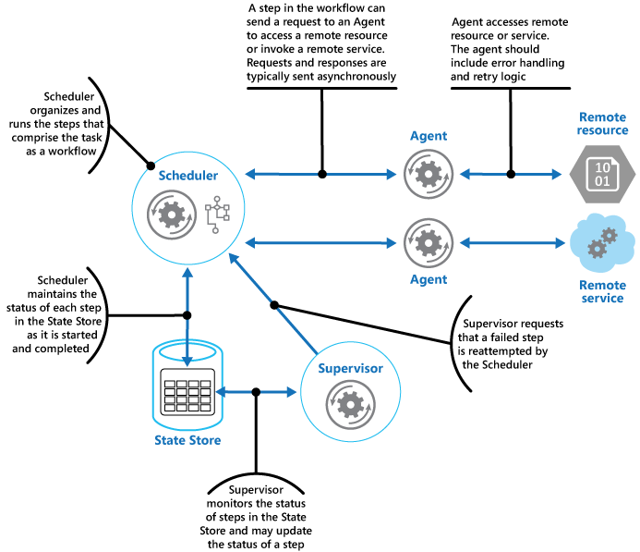
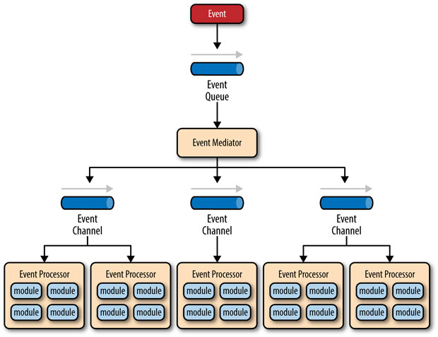
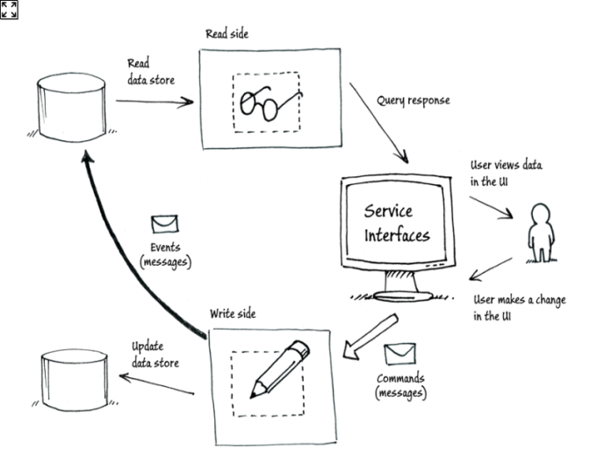
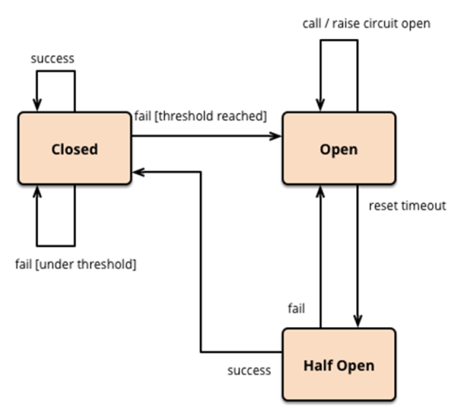
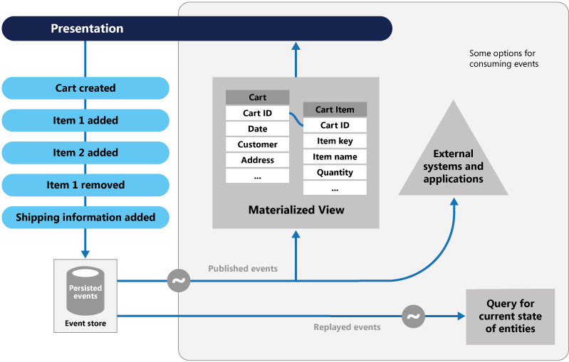
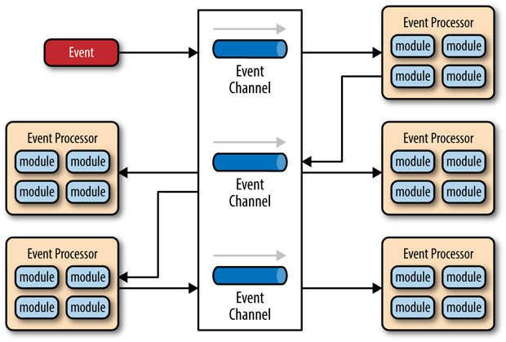
Microservices Patterns
Patterns
Service Orchestrator(Scheduler Agent Supervisor)
Event Driven Architecture – Event Mediator (Orchestration)
Command Query Responsibility Separation
Detailed Patterns in Microservices RA
Circuit Breaker
Event Driven Architecture – Event Sourcing
Event Driven Architecture – Event Broker
(Coordination/Choreography)

Slide 16
Below are some reasons when to use and not to use a Microservices approach
Fit for Purpose Model
When to use | When not to use | Reasoning
Change is frequent; Agility / Speed to Market is critical | Change is in-frequent | Immutable, independent, smaller, simple services make things faster
Highly scalable with option to deploy in the cloud | High scalability or cloud deployment is not important | Microservices exist inside a container that can be independently scaled
Components of the architecture can be broken into smaller services | Components of the architecture cannot be broken into smaller or services; e.g. single shared data store is required across multiple services | Smaller components are easier to develop, deploy, and scale
A service can be changed and it can be deployed by itself without changing anything else | Service is coupled to other services and changes must be deployed together with them | Microservices have their own stack and are independent, reducing dependencies
Overall application complexity can be managed effectively | Other architectural styles (e.g. SOA, monolithic) may provide higher value with less complexity | Having more pieces means more management and coordination, automation is key
The desired level of data consistency and latency can be achieved | Real-time zero latency data consistency is required | Event driven architecture approach helps address data consistency, but async nature adds in possibility of latency
Most services are stateless, some stateful | All services are stateful | Stateless applications are the easiest to horizontally scale, while stateful services require additional patterns

Slide 17
Below are divisional efforts that are considering microservices along with the key use cases they are trying to solve
Use Cases
Division | Effort | Details | Use Case
Card | Rewards | TLP is the current system of record for rewards accounts, and they are tightly coupled with the accounts they belong to. The long term vision for Rewards Technology is to move away from TLP as the points bank and earn engine, and to build a suite of functionality inside of Capital One that we can leverage for enhanced functionality and resiliency; | Decompose a monolithic application to create more functionality and resiliency, reduce tight coupling
 | Imaging | Evaluating creating a microservice to put and get images to multiple image repositories, while keeping the client transparent of which repository to go to | Multiple independent services called together in orchestration/coordination
 | Payments | EPS is currently a COTS monolithic application used for batch processing for payments. There is a desire to break this up into mini-services and apply microservice concepts. | Decompose a monolithic application, apply microservices concepts to batch processing
Bank | Bank Customer Strategy | Looking at leveraging microservices for Customer Identity and Customer Contact Focus. Need to migrate all back book (Systematics, CST) to front book and customer is key; May have ~24 microservice capabilities. Primary reasons for using microservices are for 1) Speed 2) Ability to pick and chose data stores relevant to domain boundary 3) To create smaller services whose data stores can be managed as a System of Record vs. System of Reference; Plan to stitch components together with a decoupled event bus; eventually monolithic apps go away and they are broken up into the respective domain contexts; want a decoupled event bus system | Leverage polyglot persistence across services to provide developers freedom of data store choice; Integrating stateful human centric processes as clients in 2/3 of the services Desire federated services Leverage event bus with event driven architecture

Slide 18
Below are divisional efforts that are considering microservices along with the key use cases they are trying to solve (continued)
Use Cases
Division | Effort | Details | Use Case
Digital | Enterprise API platform (EAP) | Evaluating using microservices in EAP | Smaller services
 | Mobile Wallet | Planning to use in 4 different capabilities: Trip grouping – Look at the Card & Bank authorization stream and determine if customers are on a trip, if so, group transactions together ; will probably have at least two microservices: 1) service that determines trustworthiness of GPS data 2) produce trip output data Customer receipts - adding more functionality to push notifications in mobile wallet for transactions (e.g. taking picture of receipt); Microservices would a) capture and store transaction id, image; b) perform OCR on receipts Second Look - Look at the authorization stream for specific activities and verify them with the customer, such as : a) Double swipes b) Blank tip lines on restaurant receipts Device Whitelist/Blacklist – would have several microservices including : a) authenticate the mobile device id using InAuth b) add device id to a whitelist/blacklist data store; Fraud group to leverage the data to track fraud cases; c) degraded authentication mode when InAuth is down using OS device ID (software level, not hardware) in mobile wallet, | Each microservice has its own data store and is storing the keys of data that may exist in other services; Any limit to number of operations in a microservice?

Slide 19
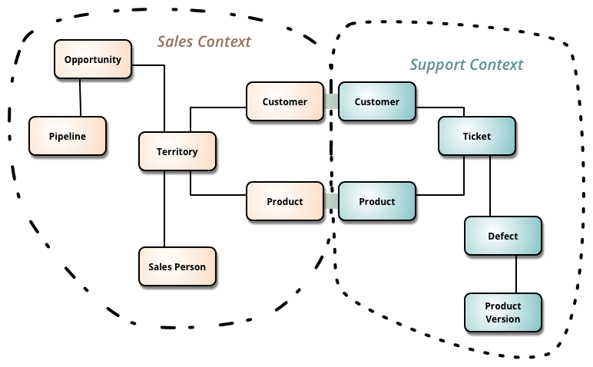
Use Case - How to break apart a monolithic application
Use Cases
Divide a monolithic application into different bounded contexts
Specific sub-models of a software application
Some ways to identify the different bounded contexts include
When the language in a model changes
If it is becoming difficult to fit everything into a unified model
Single Responsibility Principle (Robert C Martin)
gather together those things that change for the same reason, and separate those things that change for different reasons
Be explicit about the interrelationships between bounded contexts so the service can be built independently of other services.
In the below example, the language shifts from a Person responsible for a specific Territory to a Defect having a Ticket, indicating a different bounded context
http://martinfowler.com/bliki/BoundedContext.html

Slide 20
Use Case – ECR event bus w/ Event Driven Architecture Coordination/Choreography
Use Cases
Fit for purpose:
Change is frequent; Agility / Speed to Market is critical
Because the services are independent, each can be modified as frequently as needed
Highly scalable with option to deploy in the cloud –
Solution is deployed in AWS
Components of the architecture can be broken into smaller services –
ECR Monolith broken into DDD Aggregates – Customer, Account, Digital Profile
A service can be changed and it can be deployed by itself without changing anything else
Aggregate Customer, Accounts and Digital Profile
Overall application complexity can be managed effectively
The desired level of data consistency and latency can be achieved
Data is eventually consistent through Events
Services are stateless
Each Microservice produced is stateless and can be autoscaled as needed

Slide 21
For a POC, Enterprise Customer Registry (ECR) application, applied DDD principles, identified aggregates and developed microservices
Use Cases
ECR is the Bounded Context
Applying DDD principles we decomposed ECR domain model to three aggregates.
These aggregates are developed as microservices.
They are deployed in its own containers.
Data sync between them happen via events.
Domain Model within the ECR Bounded Context
Customer, Account, DigitialProfile, Preferences are entity objects
Customer
enterpriseCustomerId
firstName
lastName
dateOfBirth
SSN
Customer
Account
DigitalProfile
enterpriseCustomerId
firstName
lastName
dateOfBirth
SSN
accountRefId[]
digitialProfileRefId[]
accountId
sorAccountId
sorCustomerId
sorId
status
preferences
enterpriseCustRefId
digitalProfileId
digitalProfileName
issoId
status
preferences
enterpriseCustRefId
accountRefId[]
*
*
DDD
Account
DigitalProfile
accountId
sorAccountId
sorCustomerId
sorId
status
preferences
digitalProfileId
digitalProfileName
issoId
status
preferences
*
customerdb
accountdb
digitialpfdb
Event Bus
*this slide is from Gnanendra Dathathreya’s microservices-poc.ppt

Slide 22
Appendix

Slide 23
Below are some common characteristics of a microservice
Overview
Key Characteristic | Description
Small, focused on doing one thing well | Is a unit of functionality that provides a set of capabilities oriented around a domain, known as a bounded context; provides a single responsibility Small keeps the service nimble, easy to change, easy to understand. Automation is key to manage the lifecycle - development, build, test, staging, production and distribution
Separate, independent, has its own stack | Only way to access the service is through defined boundaries behind an API interface; Does not share its middleware or database tables; Owns its own data; Is a unit of deployment and can be changed, tested and deployed without impact other areas of a solution; Versioned API – provides clients flexibility for when to move to the new version; Versions are immutable meaning you deploy a new version in production, instead of deploying over an existing version
Scalable, highly distributed, resilient | Can be horizontally scaled up and down as needed and can be deployed in the cloud; Designed for failure; Applications are composed from multiple microservices; Interactions use decentralized choreography vs. centralized orchestration; Event driven architecture approach can provide more effective scale, resiliency, and backflow
The Microservices Architecture approach is not based on all-new principles, rather it combines proven frameworks, architecture patterns and best practices
Notes:
Eric Evan’s Domain Driven Design helped us understand the importance of representing the real world in our code, and showed us a path towards better ways to model our systems. Continuous Delivery showed how we can more effectively and efficiently get our software into production, instilling in us the idea that we should treat every check in as a release candidate. Our understanding of how the Web works has led us to develop better ways of having machines talk to machines. Virtualization platforms allowed us to provision and resize our machines at will, with Infrastructure Automation giving us a way to handle these machines at scale. Some large, successful organizations like Amazon and Google espoused the view of small teams owning the full life-cycle of their services. And more recently Netflix has shared with us ways of building anti-fragile systems at a scale that would be hard to comprehend just ten years before.
Domain Driven Design. Continuous Delivery. On-demand virtualization. Infrastructure automation. Small autonomous teams. Systems at Scale. Microservices have emerged from this world. They weren’t invented or described before the fact, they emerged as a trend, or a pattern, from real-world use. But they only exists because of all that has gone before.

Slide 24
Below is an example of the Postal Codes microservice and how it lines up against the characteristics
Characteristic | Postal Codes
Deployed as a unit | Yes, has a cloud formation template and each instance is self contained
Well defined interface | Yes, provides 2 Get services and is read only
Domain model description | Client provides a postal code (zipcode) and service returns relevant information - city, county, state, lat/long, DMA, etc; Part of a larger capability to support the ability to automatically load pricing and region information based on the user’s location
Has separate data and owns its own data | Yes, uses postal code file based data from 3rd party which is stored in the Chef recipe; Is loaded into an Apache Solr index; Solr is called by the WAR file
Leverages continuous delivery and automation | Yes, service is destroyed and re-created every day, even if there aren't changes; the data files are updated every quarter into the Chef recipe
Immutability and ephemeral | Currently are defining their immutability strategy (only have 1 version in prod). Yes for ephemeral. Leverage ELB for auto-scaling (spin up and down in <8 mins) along with health checks with TomCat today, plan to extend in the future. Troubleshooting strategy is to completely terminate instances that are misbehaving, and let them get recreated by the autoscaling group.
*www is the only consumer of the microservice currently
**Postal codes is going through the API Gateway today

Slide 25
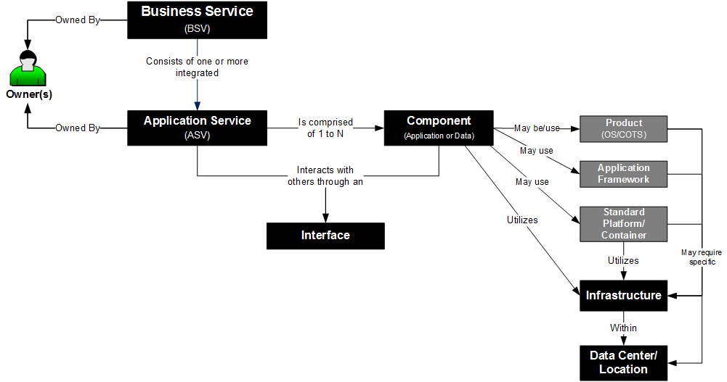
Below is how we see microservices fitting into the Architecture Meta-Model
Microservice
API Product
API End Point
Business Service (BSV): An automated or manual process or set of activities that delivers work to benefit one or more customers (e.g., Acquire Customers).
Application Service (ASV): A logical grouping of physical components that directly support a Business Service (e.g., Capstone).
Component: A logical deconstructed element of an ASV that is discrete and interacts with other components. Components must have a clear interface with another component and reside on one and only one domain. Example components include: Customer Portals, Relational Databases, API Gateways, etc.).
See the architectural meta-model for more details

Slide 26
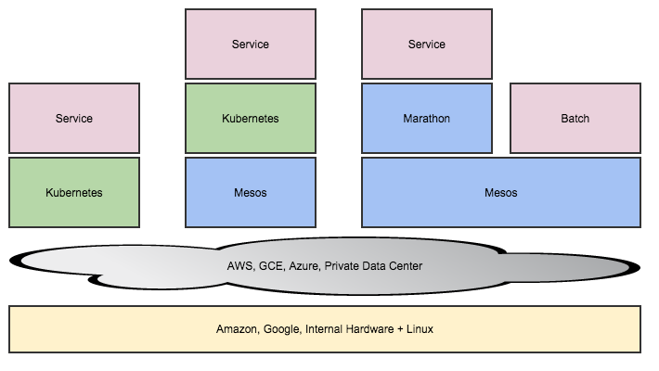
Microservices Landscape

Slide 27
Microservices Landscape Technology Options
Distributed Tracing
Dapper and Zipkin
Log centralization
Logstash, ElasticSearch, Kibana, Splunk, Logspout
Container
libContainer, Docker, Rocket, lxc/lxd
Service Discovery
Consul, etcd
Configuration
Consul, ZooKeeper, etcd
Event Queue
Kafka, ActiveMQ, RabbitMQ, Any event store with push capabilities
Template System
Ruby/ERB, Python/Jinja2,Go/Go,Shell/Sed,Consul/Consul-template
Monitoring
/stats collectd polling to favorite tool, Hysterix,
Service Registration
Registrator
Client Libraries
Finagle, roll your own
Consumer Driven Contracts
Pacto, Pact
Continuous Integration
Jenkins, mvn, drone, gocd
Orchestration
Docker, Kubernetes, Vulcand and Gogeta
Reactive Client Libraries/Functional programming

Slide 28
Containers Landscape
Monitoring Log File Collection Distributed Tracing Stats Collection Monitoring Console Indexing | Security & Networking Software Defined Multi-host Networking Isolation Host Hardening Update and Patching | Data Movement File System Replication Volumes Distributed Database DBaaS | Runtime Services Service Discovery Configuration Utilization Management Multi-tenancy Batch
Container Deployment Services Template System Orchestration Image Registry Scheduling
Container Management (Packaging-Isolation and Updates) Cluster Management, Cluster Deployment, Registry, Networking Management
Host Management Automated Provisioning, Container OS
Infrastructure Services (HW Fault tolerance) Public Cloud Private Cloud Multi Cloud

Slide 29
POC developed 3 microservices, built them as Docker containers and deployed in AWS. Each microservice owns its database, and syncs with others via events.
Customer microservice
Account microservice
DigitalProfile microservice
Customer-ms.jar
events
events
account-ms.jar
digitalprofile-ms.jar
Spring-boot-Tomcat
Spring-boot-Tomcat
Spring-boot-Tomcat
Java8
Java8
Java8
Ubuntu
Ubuntu
Ubuntu
Docker
Docker
Docker
customer-db
account-db
digitalprofile-db
MongoDB
MongoDB
MongoDB
RHEL
RHEL
RHEL
Docker
Docker
Docker
activemq
Java8
RHEL
Docker
Event bus
*this slide is from Gnanendra Dathathreya’s microservices-poc.ppt

Slide 30
POC Use cases demonstrates Event Driven Architecture
Num | Use Case | Feature
1 | Add a Customer | Initial impact: Customer microservice. Independent of other microservices.
2 | Create an Account for a customer | Initial impact: Account microservice. Independent of other microservices. Event driven syncs with Customer microservice.
3 | Create a Service Profile for a customer | Initial impact: DigitalProfile microservice. Independent of other microservices. Event driven syncs with Customer microservice.
4 | Resilient microservices | Accounts can be created even when Customer service is down. Customer Service will sync via events when it comes online.
5 | Scale Customer microservice | Horizontal, faster scaling using Docker containers. No change to other microservices.
6 | Batch Account adds | Events sync with Customer
*this slide is from Gnanendra Dathathreya’s microservices-poc.ppt

Slide 31
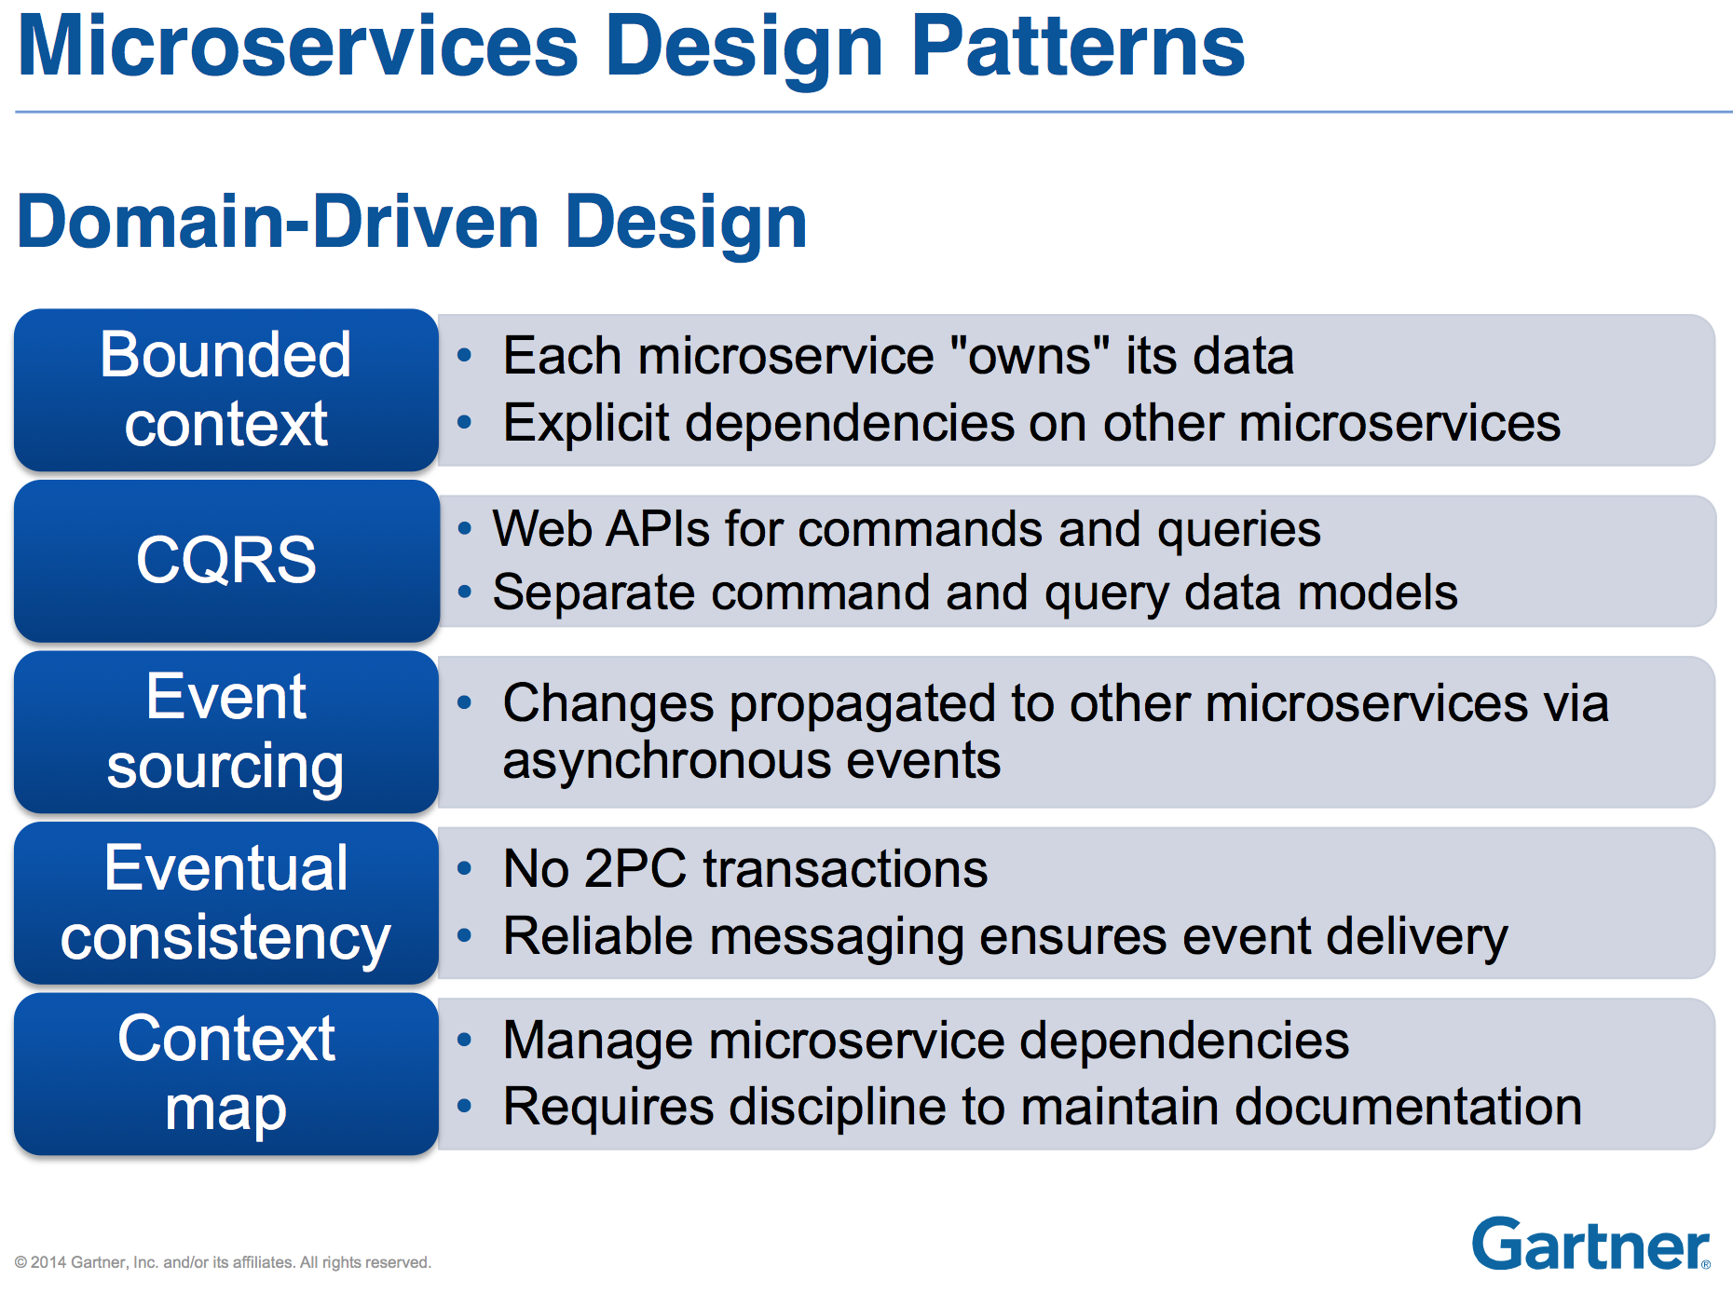
Microservices Design Patterns

Slide 32
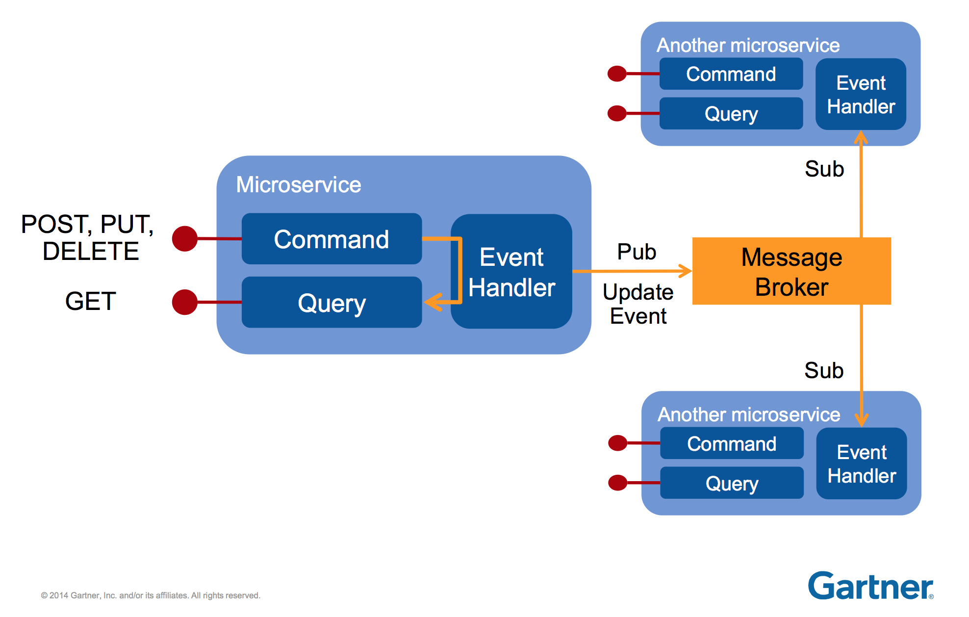
A Pattern for Microservices, but there are Many Options

